Slide 1


Green Pace
Security Policy Presentation
Developer: Evelyn Pinarello
Notes:
This is the security policy presentation for the Green Pace project

Slide 2

OVERVIEW: DEFENSE IN DEPTH
Implementing the Defense in Depth method creates multiple, cohesive layers of security to create a stronger defense against security threats and vulnerabilities.
Notes:
This presentation is meant to highlight the current security status of the organization while explaining the security risks and presenting secure solutions to strengthen the technological security of the organization and its data. Implementing the defense in depth security method creates multiple, cohesive layers of security to create a stronger defense against security threats and vulnerabilities.

Slide 3
THREATS MATRIX
Severity | Likelihood | Unlikely | Likely | Probable
Low | STD-001-C STD-002-C STD-006-C STD-010-CPP |  | STD-003-C STD-007-CPP
Medium | STD-008-CPP
High |  | STD-009-CPP | STD-004-JAV STD-005-C
Notes:
This is the threat matrix of the risks the project is currently facing, organized by the likelihood of the risk occurring and the severity of the vulnerability.

Slide 4
10 PRINCIPLES
Validate Input Data
STD-001-C
STD-003-C
STD-010-CPP
Heed Compiler Warnings
STD-006-C
Architect and Design for Security Policies
STD-005-C
STD-009CPP
Keep It Simple
STD-001-C
STD-002-C
STD-003-C
STD-010-CPP
Default Deny
STD-002-C
STD-007-CPP
Adhere to the Principle of Privilege
STD-002-C
Sanitize Data Sent to Other Systems
Practice Defense in Depth
STD-004-JAV
Use Effective Quality Assurance Techniques
STD-006-C
Adopt a Secure Coding Standard
STD-004-JAV
STD-008-CPP
STD-009-CPP
Notes:
There are 10 major security principles to focus on and these are each of the risks that align with said principles.

Slide 5
CODING STANDARDS
STD-009-CPP
STD-004-JAV
STD-005-C
STD-003-C
STD-007-CPP
STD-008-CPP
STD-001-CPP
STD-010-CPP
STD-002-C
STD-006-C
Notes:
This is the list of current risks organized by priority order. They are organized based on the priority level assigned to them in the SEI CERT coding standards.

Slide 6
ENCRYPTION POLICIES
Encryption in rest | This refers to encrypting data that is not currently in use but is still stored somewhere within the system, such as database or server. This helps to mitigate risks such as security breaches and the malicious acquisition of data.
Encryption at flight | This refers to encrypting data that is in the process or moving in to or out of the system or program. This data must be encrypted because it mitigates the potential threat of malicious data being input into the program, system, or database.
Encryption in use | This refers to encrypting data that is currently in use by the program, system, or user. Implementing the Triple A framework will help to encrypt the data in use.
Notes:
These are the encryption policies that describe the status of data and the encryption involved with it. Encryption in rest refers to data that is currently not in use but is still stored within the system. Encryption at flight refers to data that is moving in or out of the system. Encryption in use refers to data that is currently being accessed by the program, user, or system.

Slide 7
TRIPLE-A POLICIES
Authentication | This is the portion of the framework that verifies the identity of the user trying to access the data. This can include usernames, ID numbers, password, or secondary authentication such as secure codes sent to an associated email or phone number.
Authorization | This is the portion of the framework that verifies the user has the specified level of clearance to access certain data levels. This helps mitigate users having access to viewing and modifying data they do not require. This limits the number of users who have access to sensitive data.
Accounting | This is the portion of the framework that tracks the activity of the users which provides a level of security by holding users accountable for changes made from their activity. This also provides a map of activities to be reviewed and used in the event of security breaches.
Notes:
This is the Triple A Framework. Triple A stands for Authentication, Authorization, and Accounting. Authentication verifies the identity of the person trying to access the data. Authorization verifies the user has security clearance to access certain data. Accounting tracks the usage of the user and the data.

Slide 8
Unit Testing
Unit testing is “a type of software testing that focuses on individual units or components of a software system (GeeksForGeeks, 2023).
The unit tests displayed are:
Testing a collection’s capacity
Verifying resizing increases the collection size
Verifying resizing decreases the collection size
Notes:
Unit testing is software testing that focuses on individual components of a software system to mitigate issues and vulnerabilities.

Slide 9
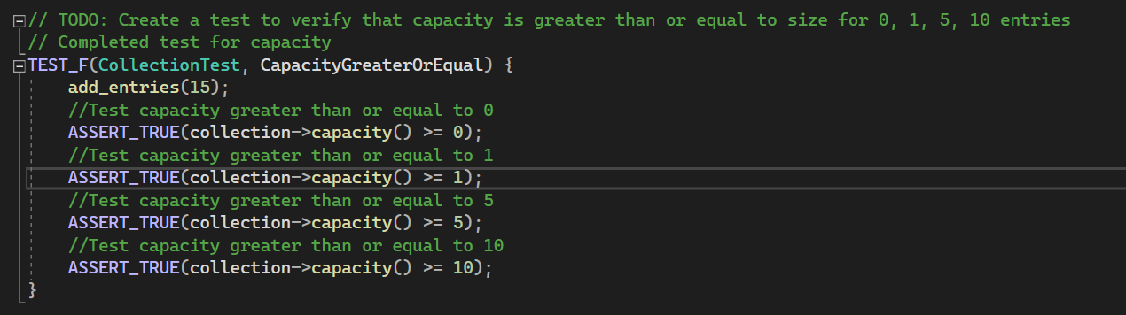
Testing a collection’s capacity
Notes:
The first example of unit testing is testing a collection’s capacity. This tests the collection in a program to determine whether the established size of the collection is greater than the determined value.

Slide 10
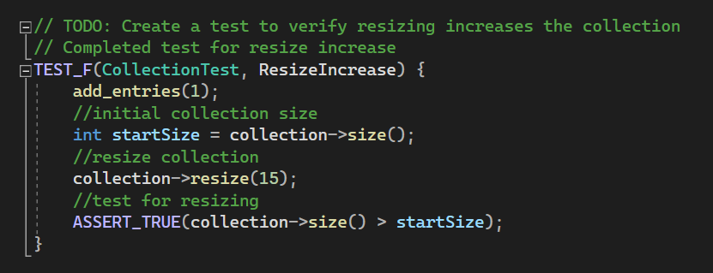
Verifying resizing increases the collection size
Notes:
The second example of unit testing is verifying resizing can increase the collection size. This tests that the collection size can be increased by resizing.

Slide 11
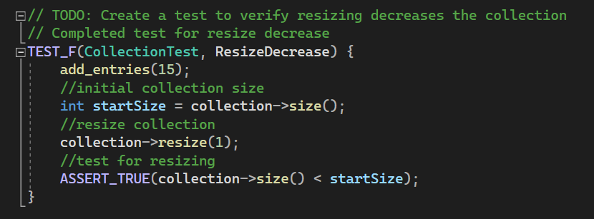
Verifying resizing decreases the collection size
Notes:
Similarly, this is an example of unit testing to verify resizing can decrease the collection size. This tests that the collection size can be decreased by resizing.

Slide 12

AUTOMATION SUMMARY
Notes:
This is the DevSecOps pipeline which introduces security measures into the current software development pipeline

Slide 13
TOOLS
The DevSecOps pipeline is a “set of security practices incorporated into the Software Development Lifecycle to build, test, and deploy secure software faster and easier” (Foster, 2021).
One of the main tools used is CPPcheck, a static analysis tool for C and C++ code that detects bugs and focuses on detecting undefined behavior and dangerous coding constructs (CPPcheck, n.d.).
Notes:
Using tools such CPPcheck to analyze C and C++ code for bugs and vulnerabilities will help implement secure code.

Slide 14
RISKS AND BENEFITS
Risks of Waiting to Act
Leaving program and sensitive data vulnerable and open to attack
Adding security later in SDLC lengthens the program’s completion timeline
Benefits of Acting Now
Security measures implemented throughout entire project
Shortens project completion timeline
Risks are easier to mitigate the earlier they are caught
Examples of Waiting Failures (Swinhoe & Hill, 2022)
Yahoo’s 2013 Data Hack
Virtually every Yahoo account was illegally accessed and stolen
Lack of Defense in Depth
Lack of Default Deny
Lack of Triple A framework
LinkedIn’s 2021 Data Hack
Over 700 million user’s data was stolen and listed for sale on the dark web
Lack of Defense in Depth
API vulnerabilities led to attack
Notes:
Implementing new security measures always presents a slight risk, due to inept implementation, but overall the benefits of implementing these measures now would mitigate the risks associated with waiting to act.

Slide 15
RECOMMENDATIONS
Implementing the Defense in Depth security method
Implementing the Triple A Security Framework throughout the project
Development team adopting the Secure Best Coding Standards
Development team implements testing throughout the development process
Notes:
My recommendation for this organization would be to implement the Defense in Depth security method and the Triple A framework while adopting the secure best coding standards and testing throughout the coding process

Slide 16
CONCLUSIONS
Implementing multiple security principles, the defense in depth security method, the Triple A framework, continual testing, and the secure best coding practices throughout the completion of the project and not as a last resort will help to mitigate security threats and vulnerabilities.
Notes:
Implementing multiple security principles, the defense in depth security method, the Triple A framework, continual testing, and the secure best coding practices throughout the completion of the project and not as a last resort will help to mitigate security threats and vulnerabilities.

Slide 17
REFERENCES
Cppcheck. (n.d.). Retrieved April 14, 2023, from https://cppcheck.sourceforge.io/
Foster, S. (2021, January 22). DevSecOps pipeline overview: Devsecops simplified. Perforce Software. Retrieved April 14, 2023, from https://www.perforce.com/blog/kw/devsecops-pipeline-overview
GeeksforGeeks. (2023, February 6). Unit testing: Software testing. GeeksforGeeks. Retrieved April 14, 2023, from https://www.geeksforgeeks.org/unit-testing-software-testing/
Hill, M., & Swinhoe, D. (2022, November 8). The 15 biggest data breaches of the 21st Century. CSO Online. Retrieved April 14, 2023, from https://www.csoonline.com/article/2130877/the-biggest-data-breaches-of-the-21st-century.html
Notes:
These are the resources I have compiled and used to understand and convey the importance on implementing secure coding methods

